Slide 1
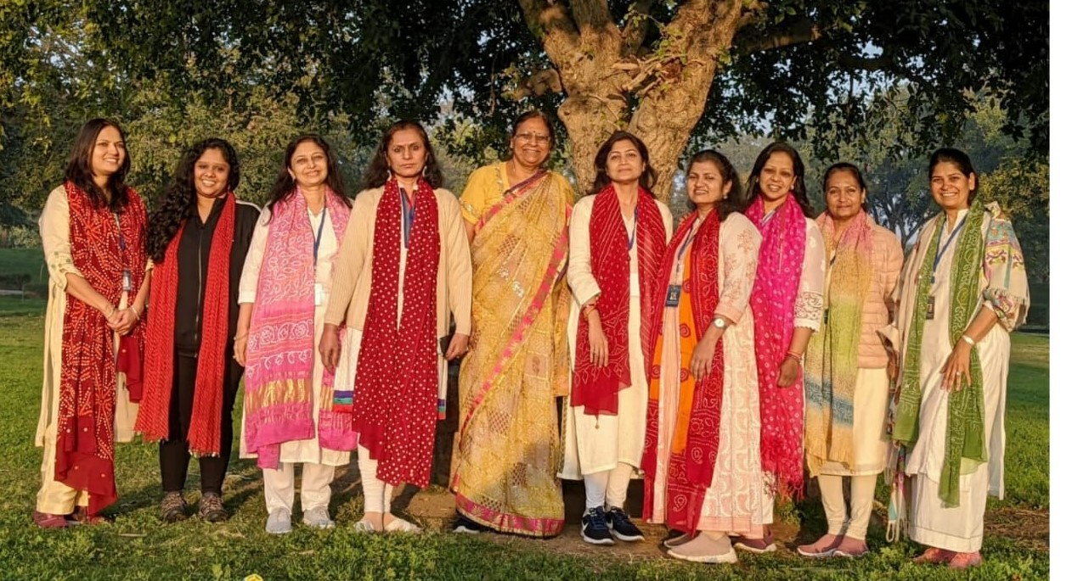
COWE RAJASTHAN CHAPTER

Slide 2
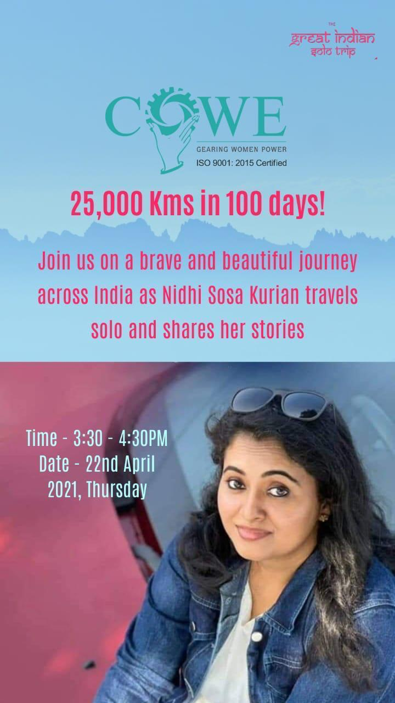
Nidhi Kurian a brave solo traveller shared her beautiful journey which is truly inspirational and gave an amazing appetite for life and taught to live it fully.

Slide 3
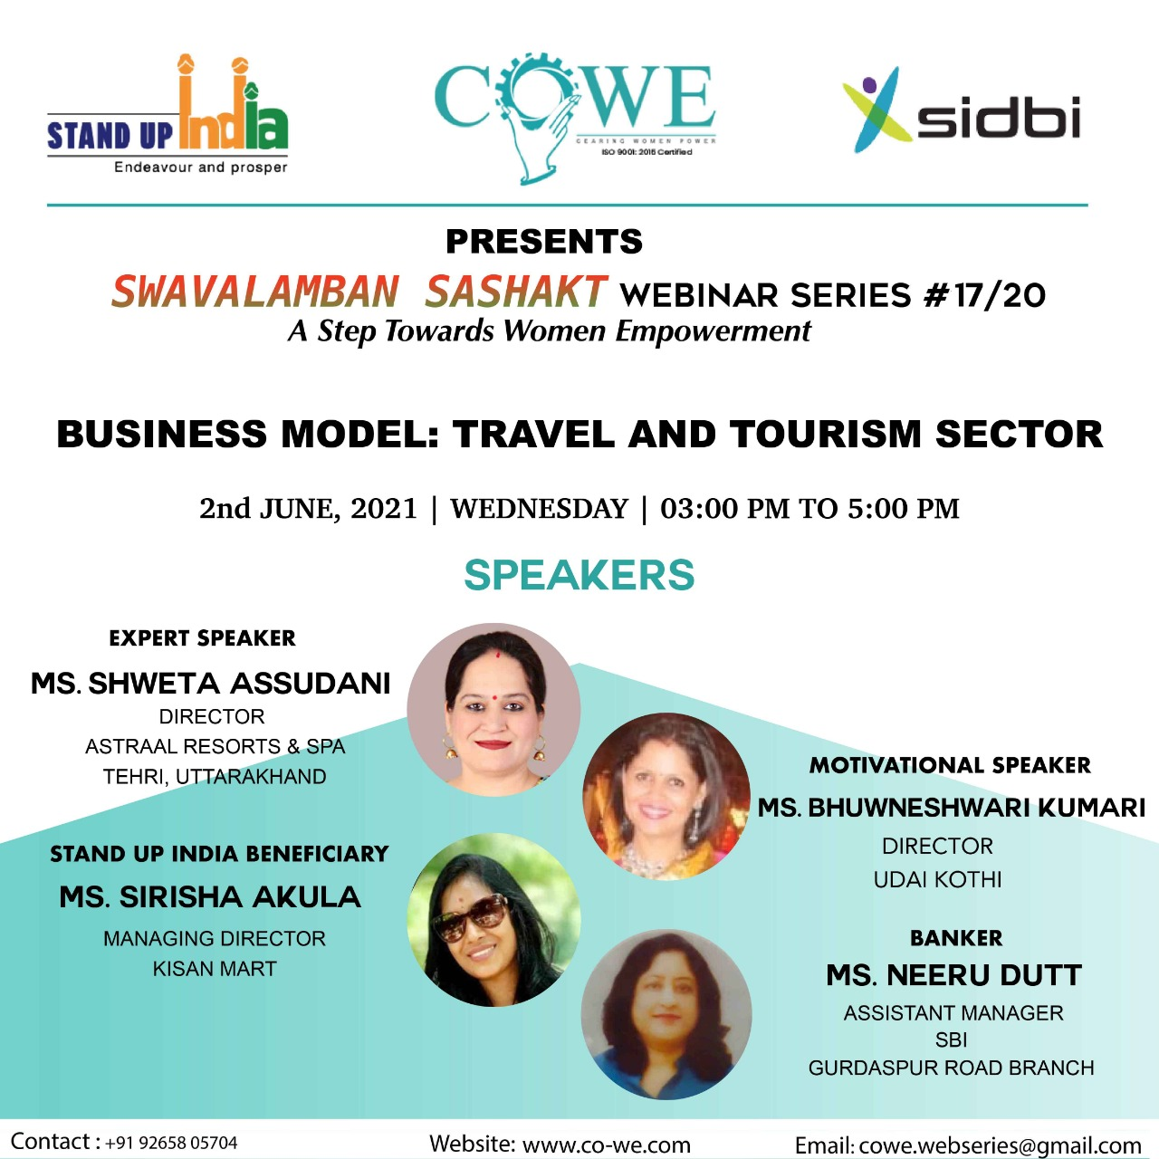
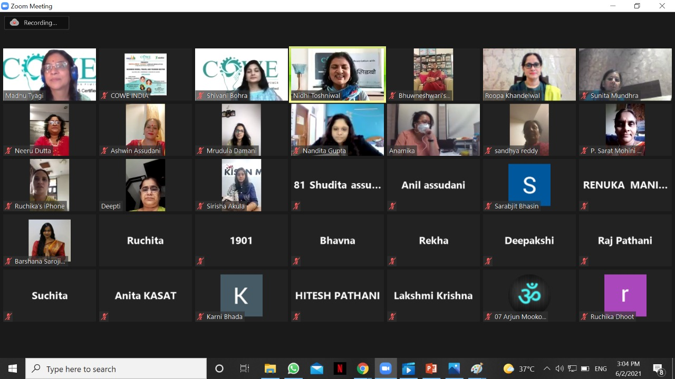
Webinar 17 # Swavalamban Sashakt webinar Series(Travel & Tourism)

Slide 4
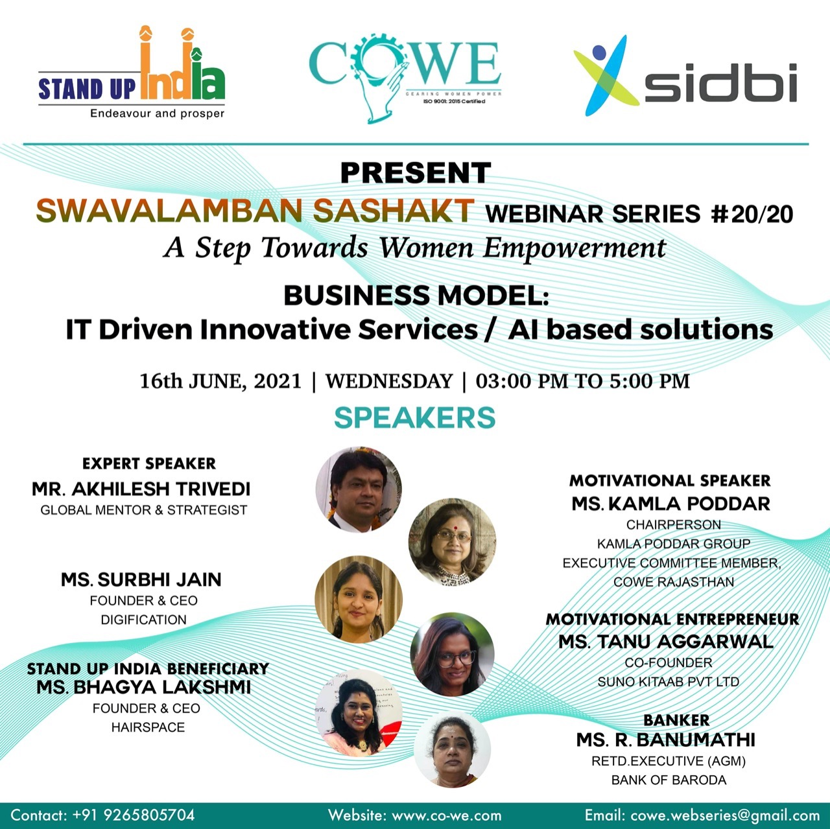
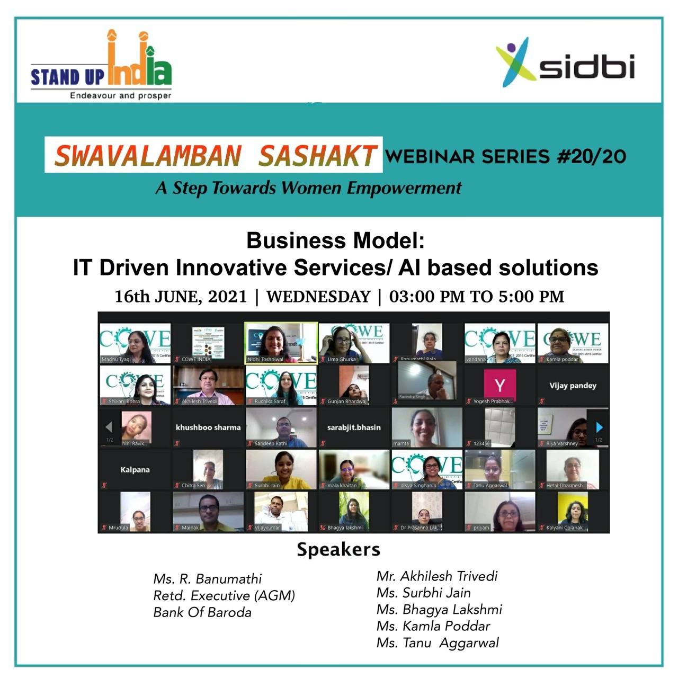
Webinar 20 #Final Webinar of Swavalamban Sashakt webinar Series(IT Sector)

Slide 5
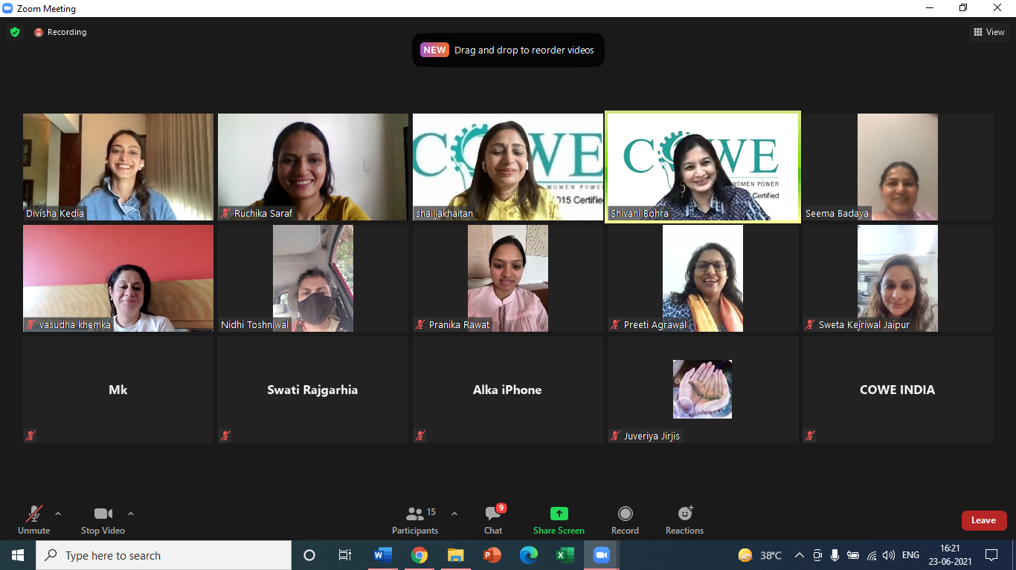
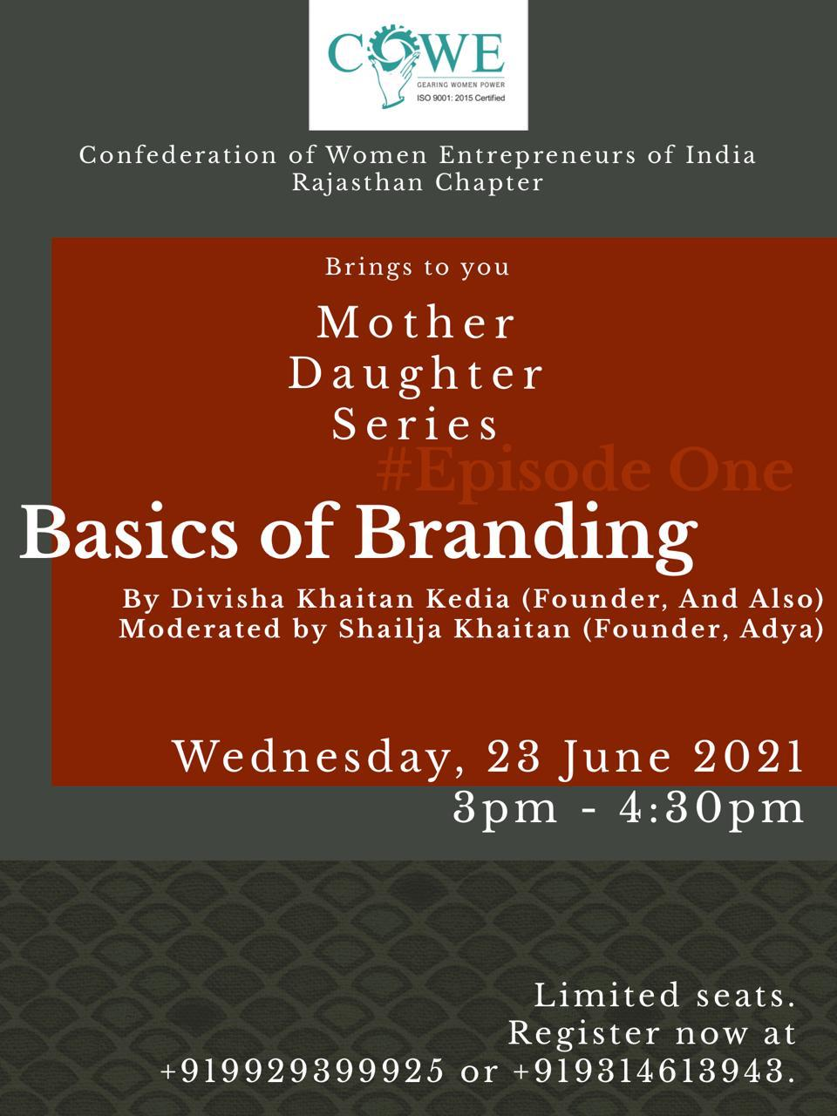
Mother Daughter Series-Part 1
Basics of branding moderated by executive committee member Ms Shailja Khaitan and presented by her daughter Ms Divisha Khaitan

Slide 6
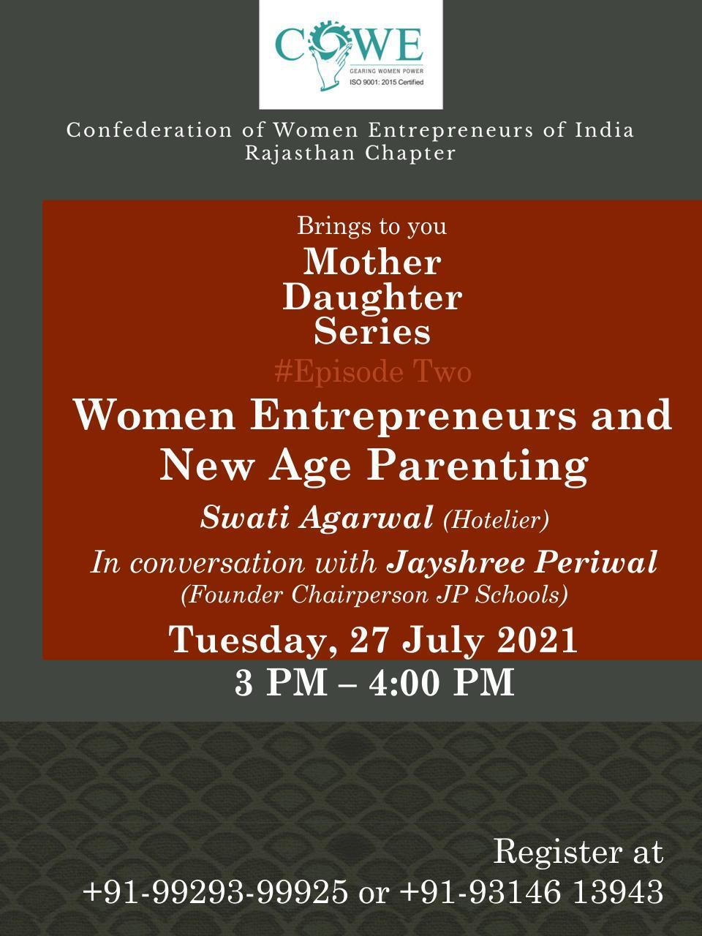
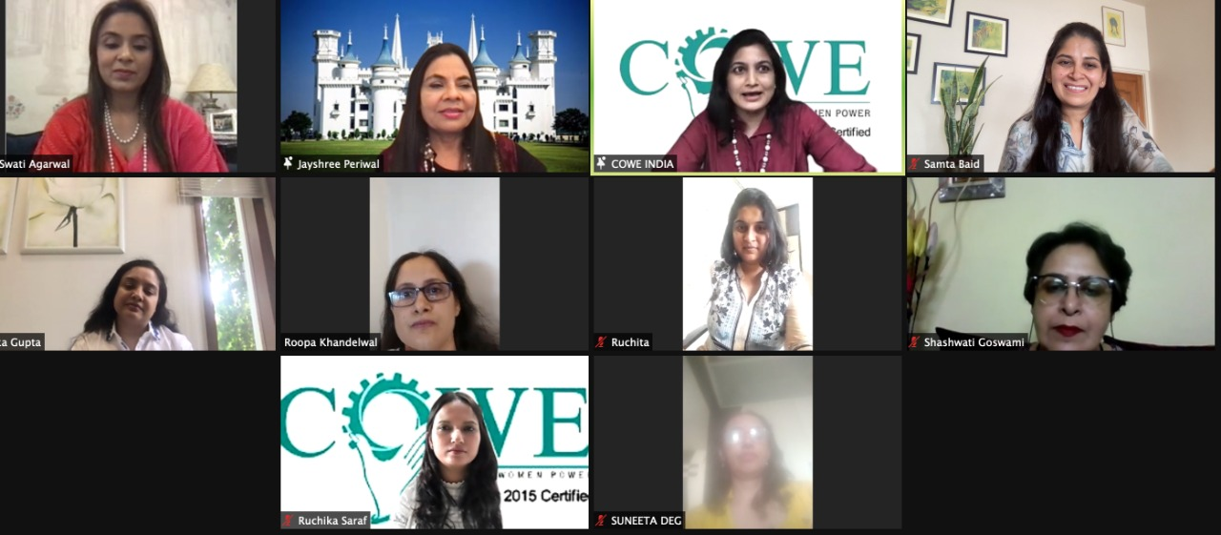
Mother Daughter Series-Part 2
Women Enterpreneurs and New age parenting by Ms Jayshree Periwal(Educationist) and her daughter Ms Swati Agarwal(Hotelier) attended by over 100 participants.

Slide 7
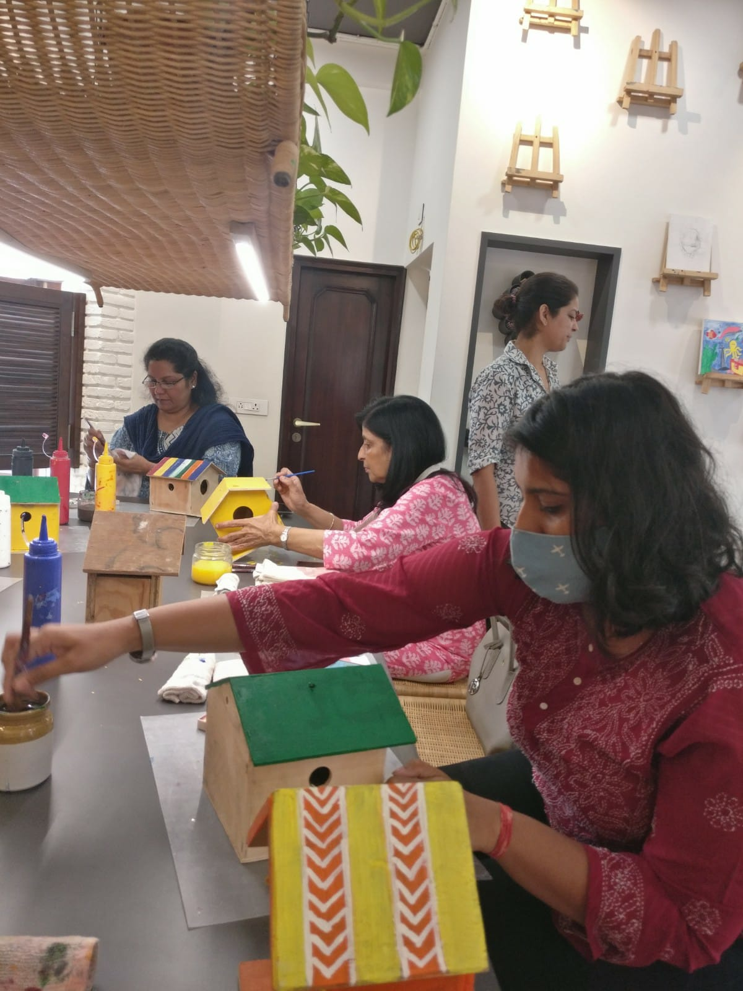
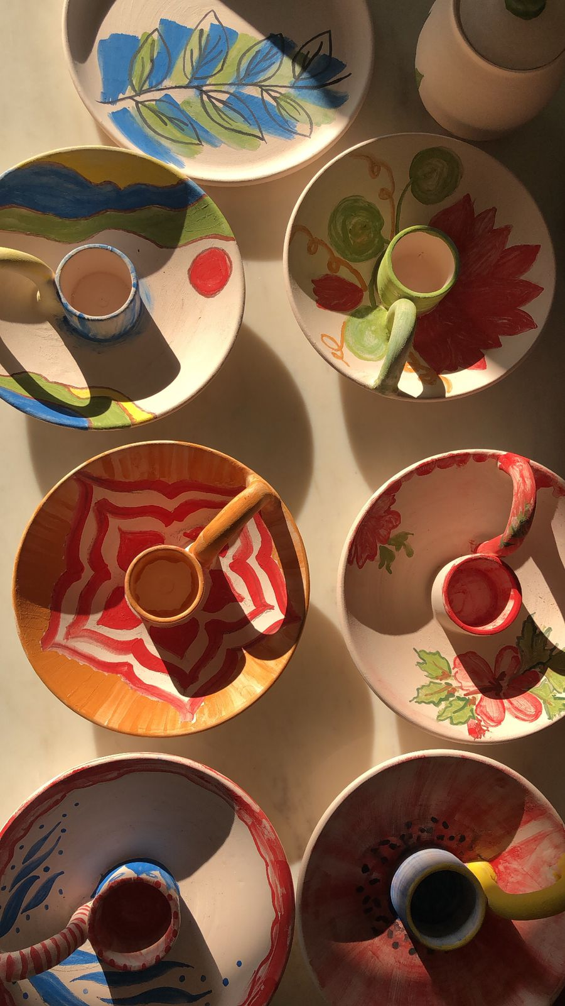
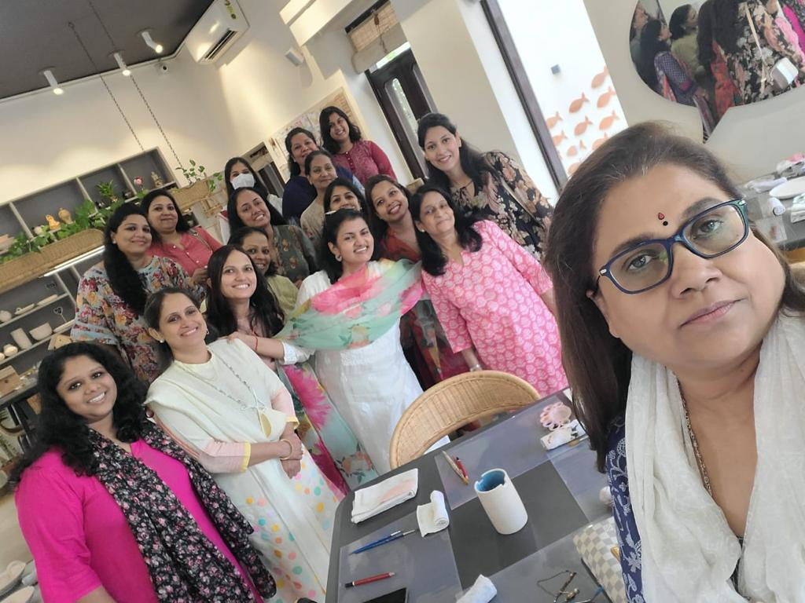
DIY-opportunity to unwind ,learn,meet friends and spread cheer ,joy with colors

